Slide 1

Which degrees really pay off?

Slide 2

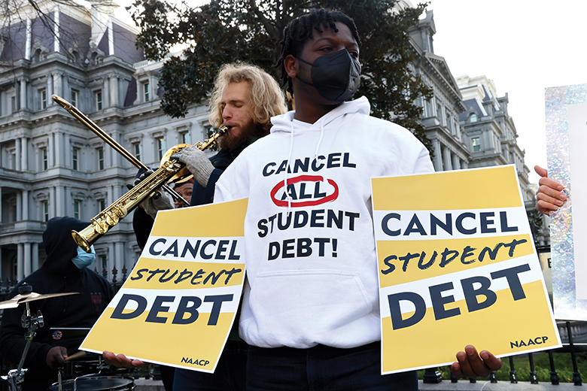
In 2022, 12.8 million, or 42.1% of American 18 to 24 year olds are enrolled in college or graduate school.
But the amount of student debt held in America is roughly equal to the size of the economy of Brazil or Australia
Are degrees worth the financial strain?

Slide 3

How much do the different degrees pay on average?

Slide 4
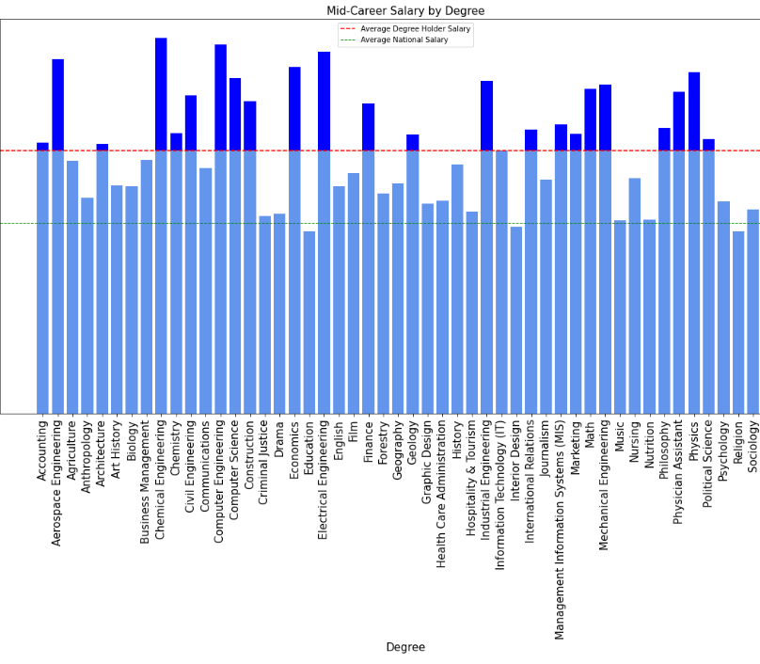
Not all degrees grant an average pay above the national average.
The difference in average pay amongst degree holders can be substantial depending on the degree.

Slide 5
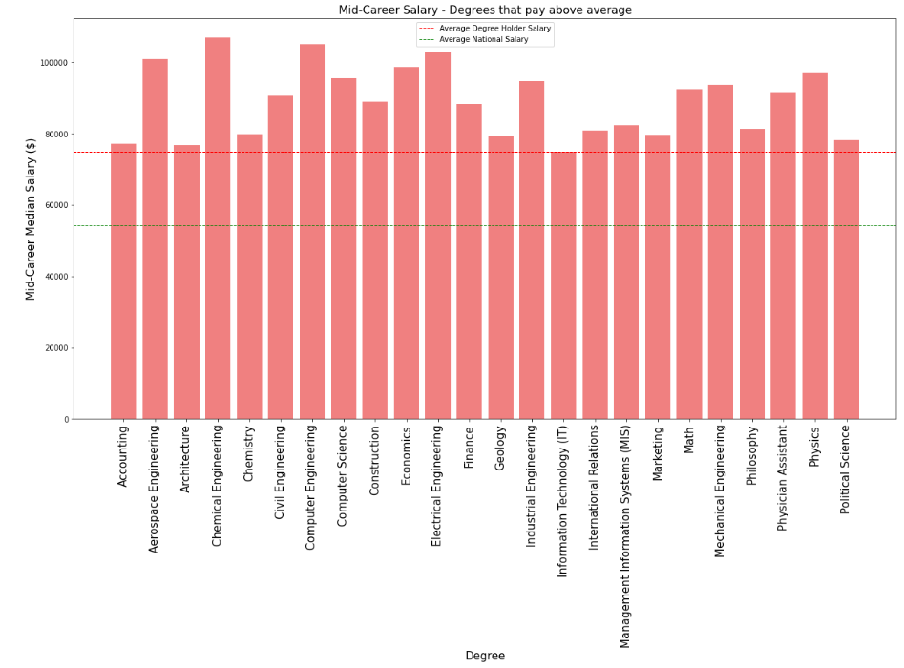
These degrees pay above both the national average and the average of degree holders.

Slide 6
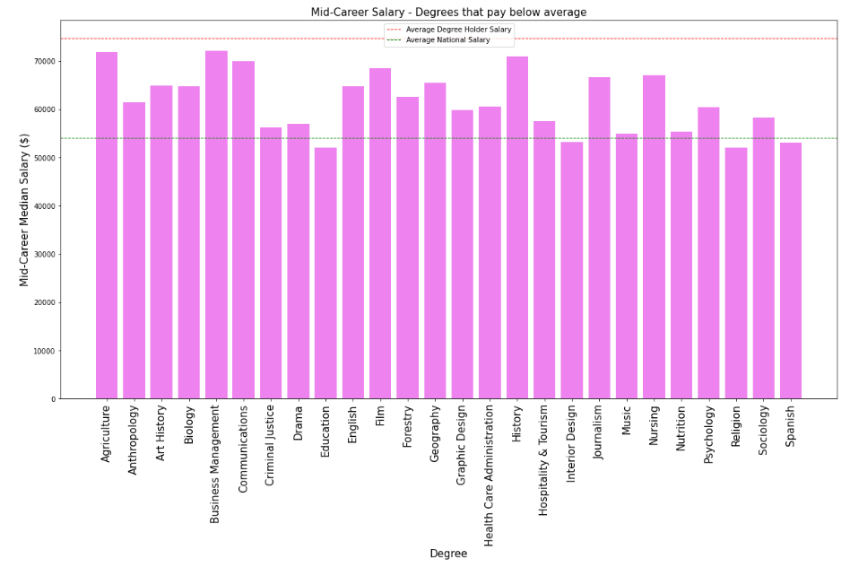
Some degrees don’t even pay above the national average salary

Slide 7

But these averages don’t tell the full story…

Slide 8
Does it matter which University you choose?

Slide 9
Salaries by college
Degrees that pay back
Salaries by region
Clean(replace “$” and “,” and convert to float
Cleaned data
Create subset to keep only required variables
Create subset to keep only required variables
Subset
Assign rank based on starting median salary and mid career median salary
creating subset Data frame(school type)
Data frame with ranks.
Plot four bar charts
Based on school type finding average salary
Correlation between mid career median salary & starting median salary
Plot bar chart
Top 10 college (SMS)
Top 10 college(MCMS)
Bottom 10 school(SMS)
Bottom 10 school(MCMS)
Generating the regression line and scatter plot

Slide 10
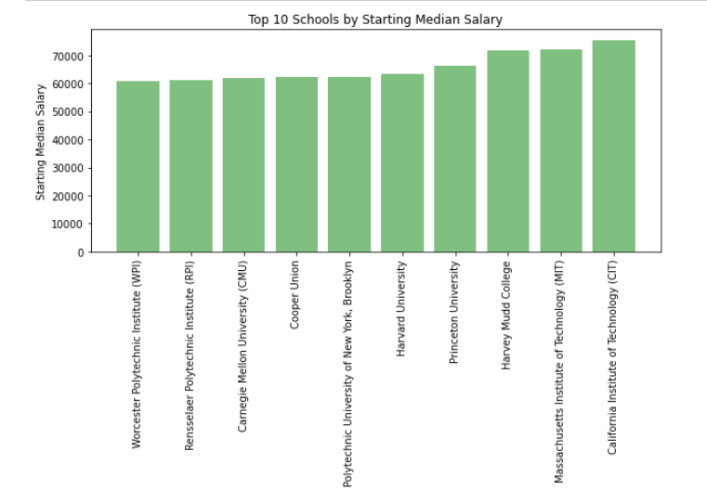
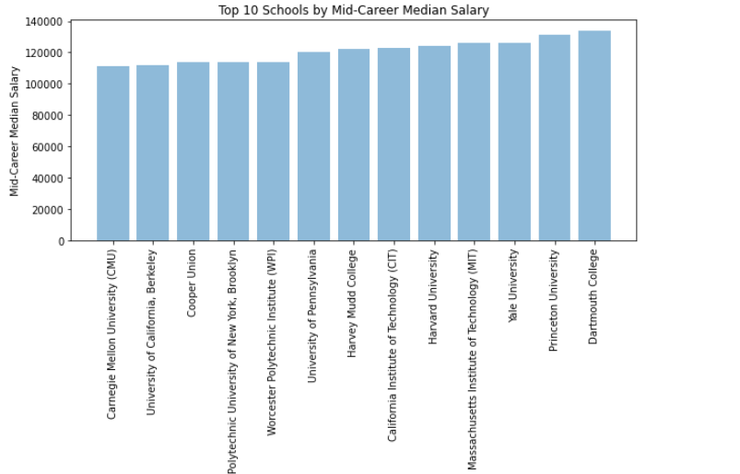
Plot bar chart top 10 school based on starting median salary and mid career median salary

Slide 11
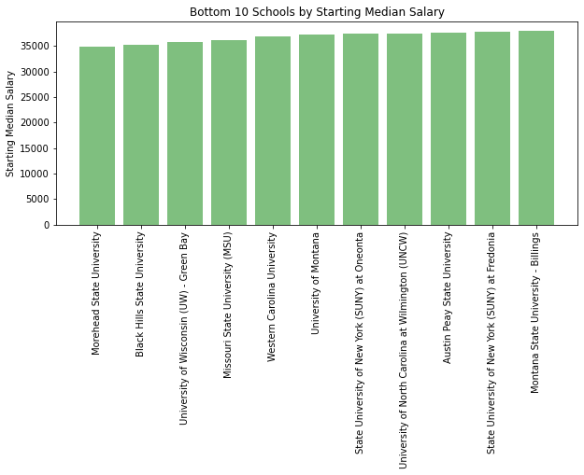
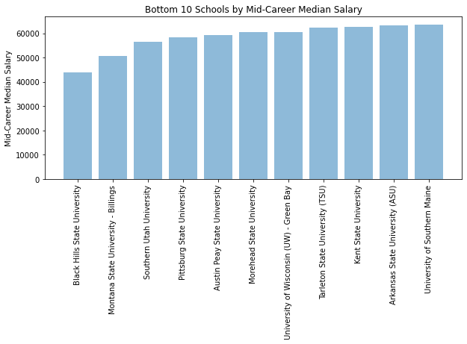
Plot bar chart bottom 10 school by starting median salary and mid career median salary.

Slide 12
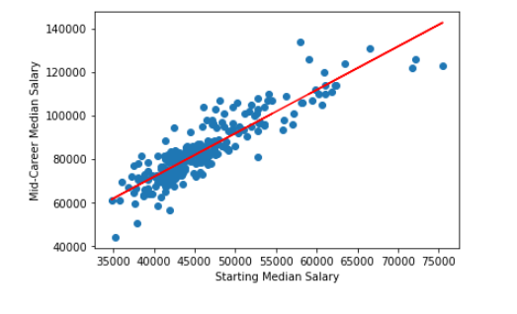
Generating the regression line for plotting
Scatter plot Mid-Career Median Salary Vs Starting Median Salary

Slide 13
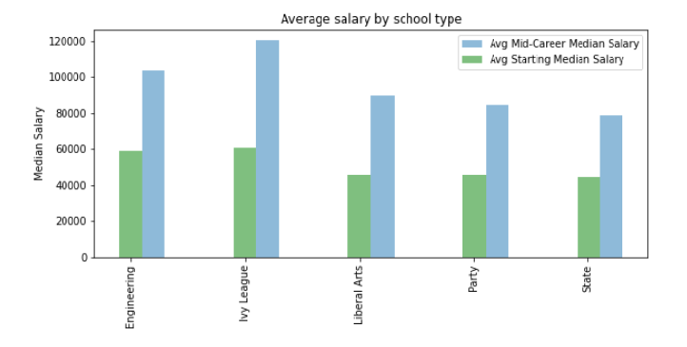
Based on school type finding average salary

Slide 14
Conclusion
Dartmouth College have highest average Mid career median salary and California Institute of Technology have highest average starting career median salary.
Black Hills State University have lowest average Mid career median salary and Morehead State University of Technology have highest average starting career median salary.
There is strong positive corelation (0.89) between Starting median salary and Mid-career median Salary.
Ivy League school type has highest average Mid-Career median salary and average Starting median salary.
State school type has lowest average Mid-Career median salary and average Starting median salary.

Slide 15
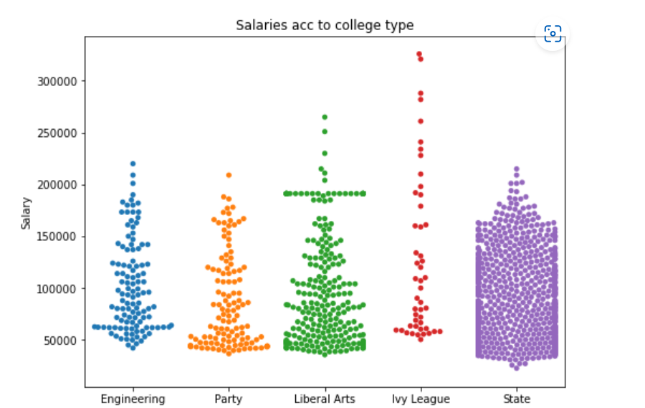
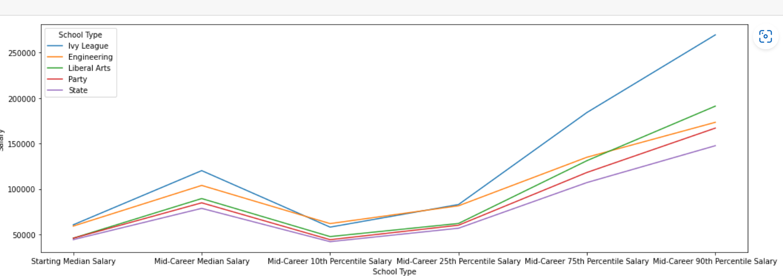
Even though engineering and Ivy League schools' alumni make the same on average, the top earners from Ivy League schools out-earn the rest of the degree holders.

Slide 16
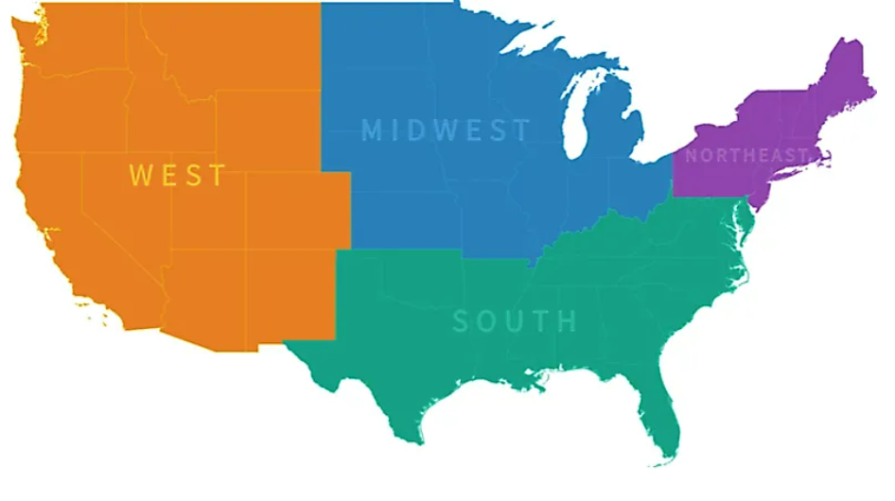
Does it matter where?

Slide 17
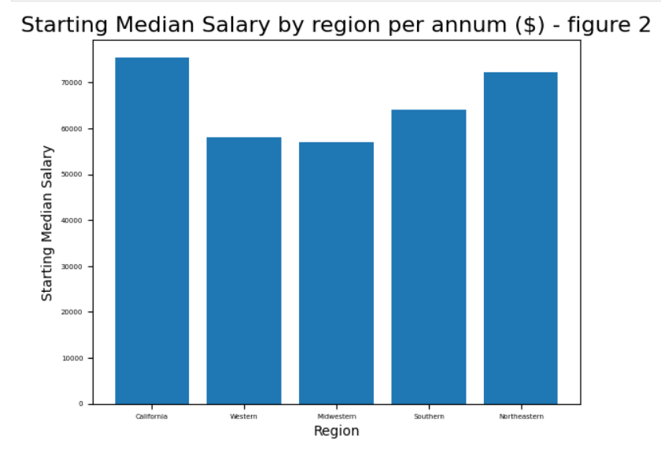
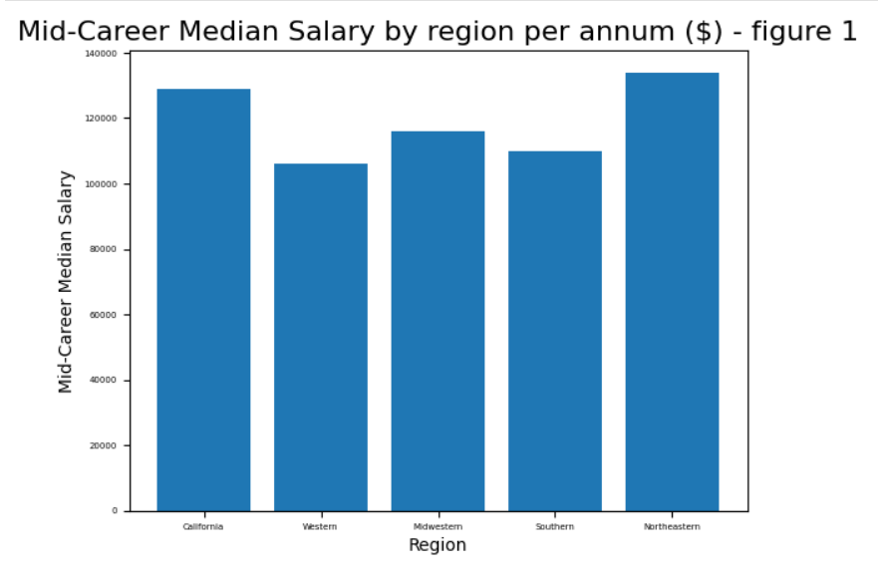
Graduates from Californian universities start roughly with the same salary than graduates from Northeastern region.
Universities from the Northern area take the top spot (Ivy schools) followed closely by the universities in California when it comes to mid-career salaries.

Slide 18
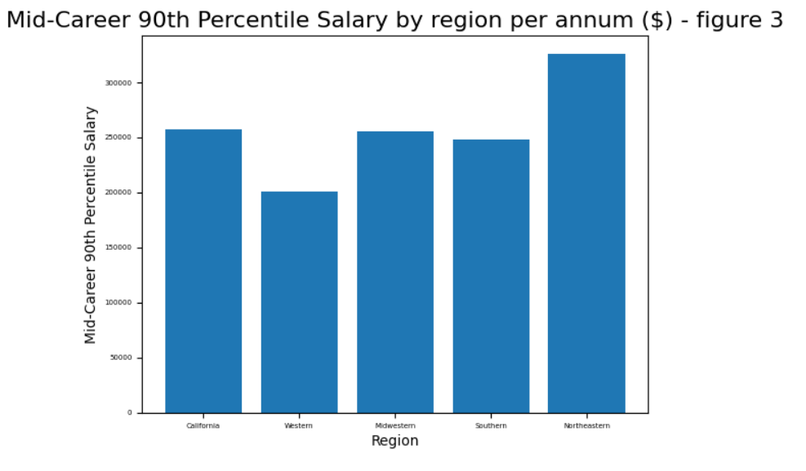
Mid-career salaries for the top 10% are higher for those who studied in the Northeast (Ivy League Universities).

Slide 19


Do all degrees have the same growth prospects salary-wise?

Slide 20
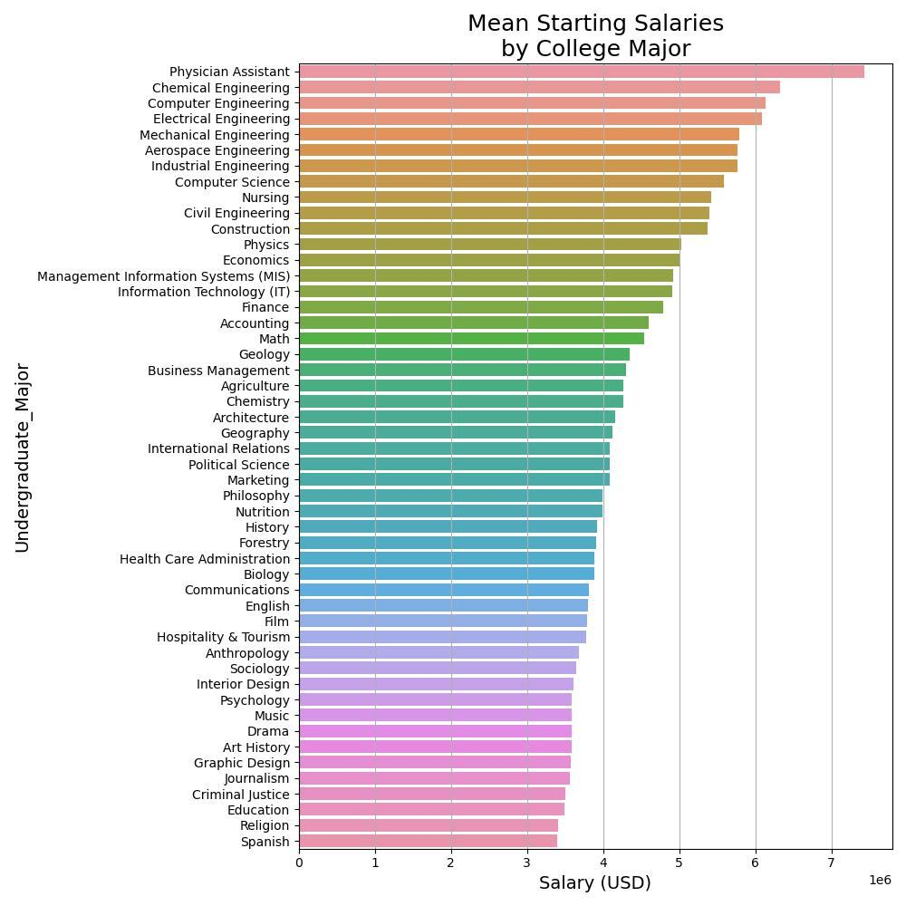
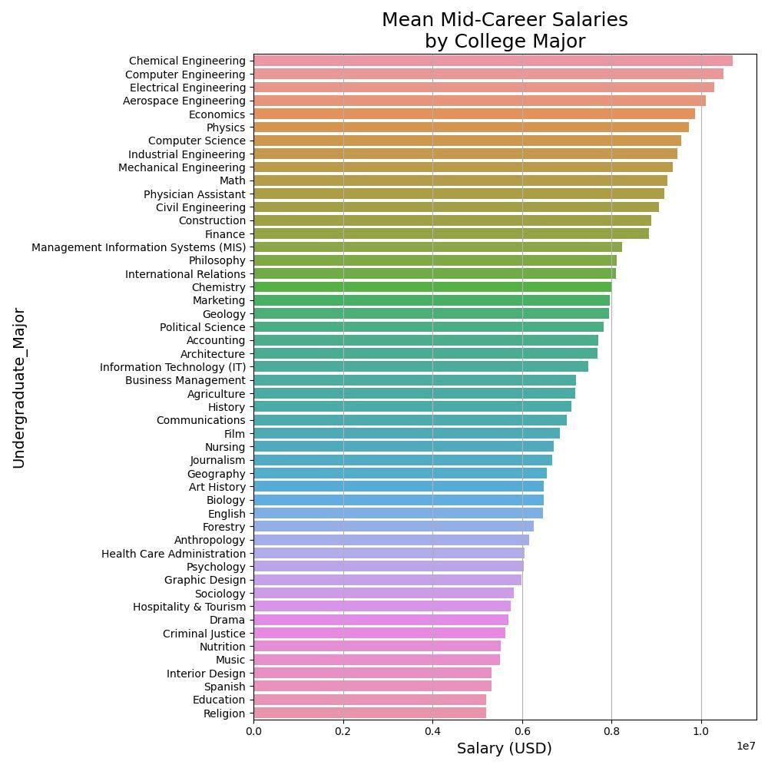
Not all professionals increase their salary at the same rate

Slide 21
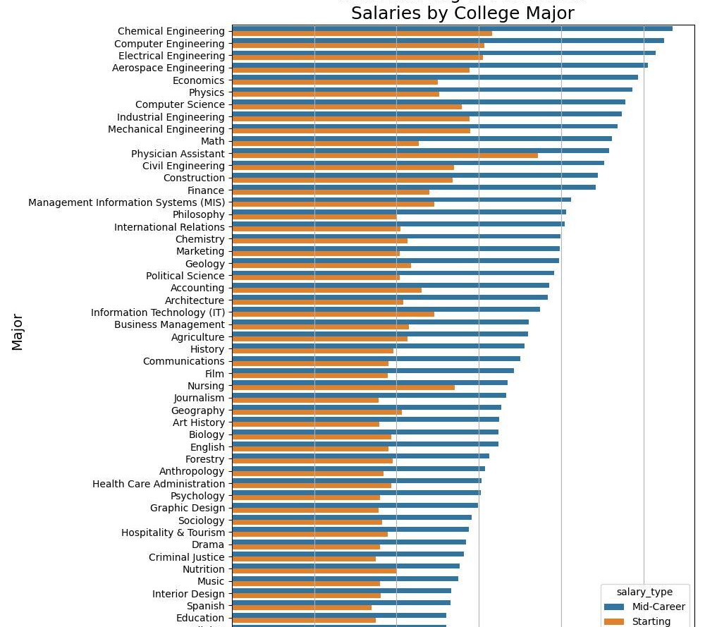
Some degrees don’t have a high starting salary but may even double by mid-career.
The degrees that provide the higher salaries right out of college are not the ones that have a greater salary mid-career necessarily.

Slide 22
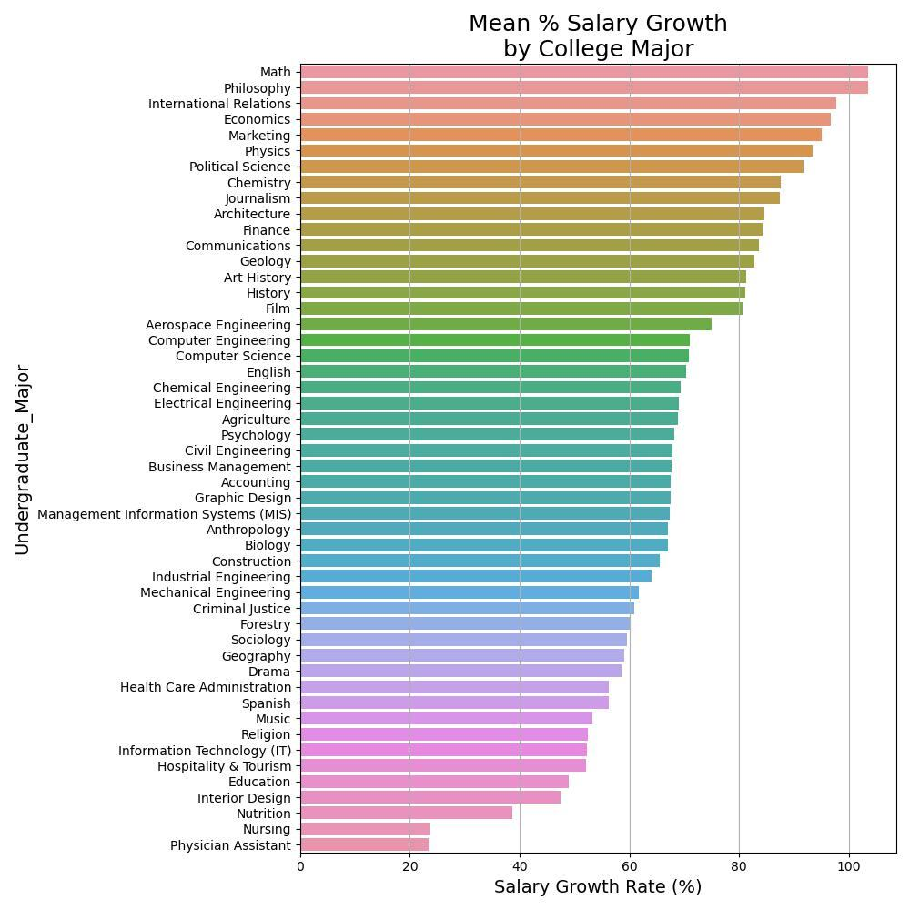
The average that each degree increases its average salary can vary substantially

Slide 23

Which disciplines pay best?

Slide 24
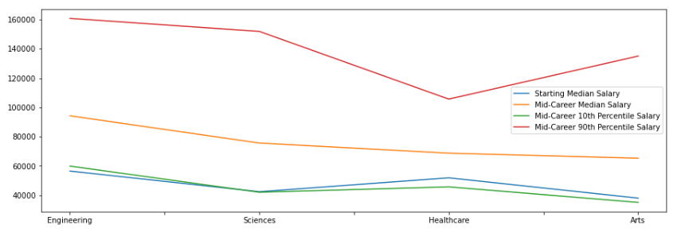
Some disciplines pay better than others.
Engineering is the best paid disciplines at all stages of a career.

Slide 25
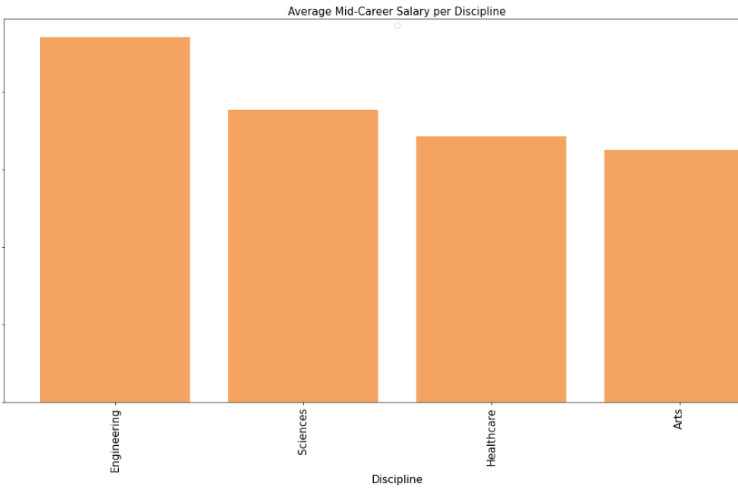
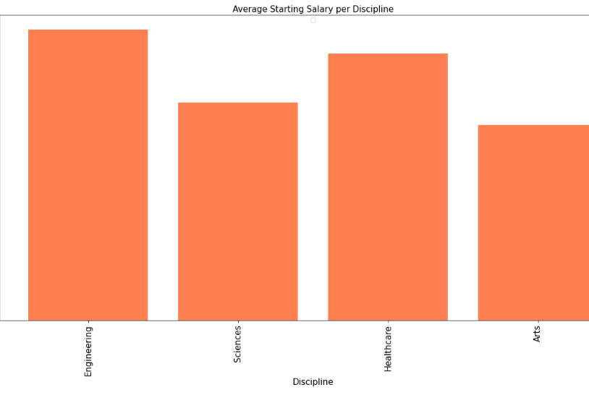
Regardless of the university, some careers have a higher salary than others

Slide 26
So… What should you study?

Slide 27

If you just want a good paying job…

Slide 28
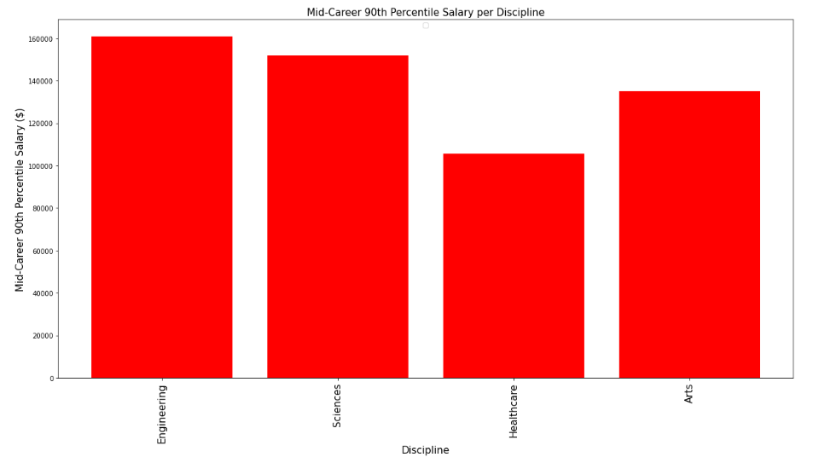
Top earners in each discipline make a good salary.
But… will you be a top earner?
…It’s not that simple!

Slide 29
The university you go to, matters!

Slide 30
…But it also matters the degree you get!

Slide 31


